Slide 1

Using WRF to Understand and Model Marine Fog
Understanding the microphysics scheme in WRF to study marine fog.

Slide 2
Purpose
Many weather models: overestimate the liquid water content (LWC) → thicker layers.
Reduced visibility measurements compared to observations.
The goal is to find a more accurate depiction of marine fog in the model.

Slide 3
Background Information
What is WRF and why WRF-SCM?
Why the Thompson microphysics scheme?
Based on the “Surface Deposition of Marine Fog and its Treatment in WRF Model” paper.

Slide 4
What is WRF and why WRF-SCM?
WRF (Weather Research and Forecasting): atmospheric model for meteorological research and numerical weather prediction. [1]
It involves various physical parametrization schemes.
The single-column model case (WRF-SCM): ideal case in WRF.
Vertical interactions dominate many physical processes. [2]

Slide 5
Why the Thompson microphysics scheme?
Microphysics provides atmospheric heat and moisture tendencies. [1]
It deals with the different particle types and their processes which are relevant to clouds.
Based on previous studies, it was concluded that the Thompson scheme performed better for marine fog studies.

Slide 6

Why the Thompson microphysics scheme?
Thompson microphysics scheme: a constant cloud droplet number ($N_{c}$) and the default is 100 $cm^{−3}$.
Thompson Aerosol-Aware scheme: in contrast to the older scheme, $N_c$ is resolved explicitly and is a predicted variable. [4]

Slide 7

“Surface Deposition of Marine Fog and its Treatment in WRF Model” paper
Investigated the boundary layer scheme in WRF for marine fog.
Introduced a turbulent deposition velocity to account for fog droplets coalescing with the sea surface. [5]
This is parametrized using the roughness length z0c in the equation below:
$$V_{d}= \frac{u_{∗}k}{ln(\frac{z1+z0c}{z0c})}$$
, where $u_{∗}$ is the friction velocity, k is the Karman constant and z1 is height.

Slide 8
Method
4 days simulation from August 15th to 19th 2018.
Used the MYNN surface layer with z0c, no radiation schemes for simplicity, and a 6-hr surface cooling.
Used Thompson microphysics scheme for maritime cases.
Used Thompson aerosol-aware scheme for further investigation.

Slide 9
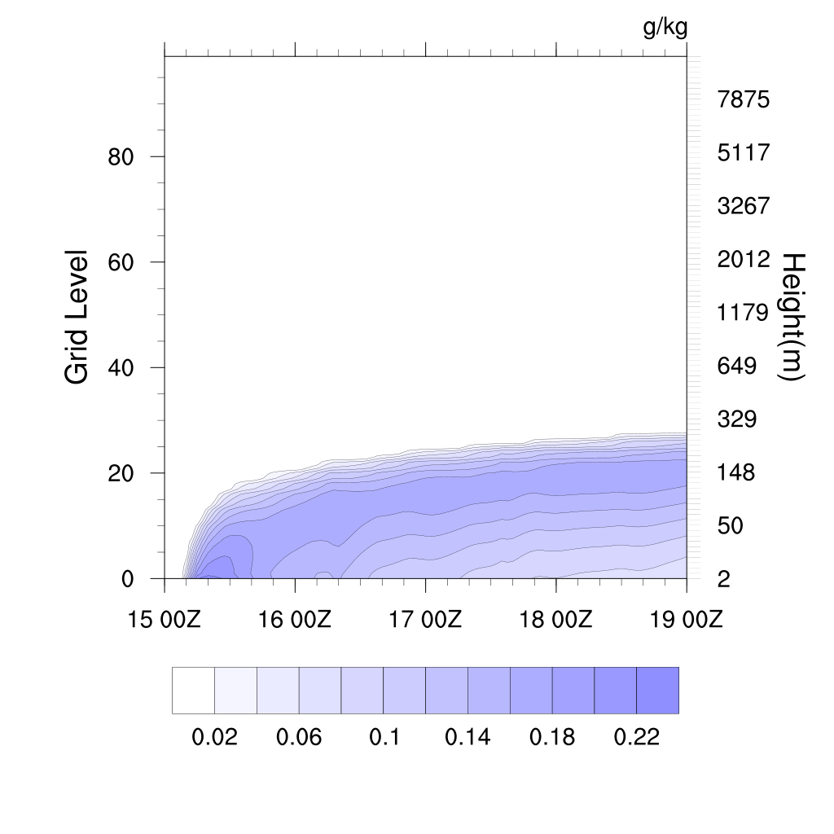
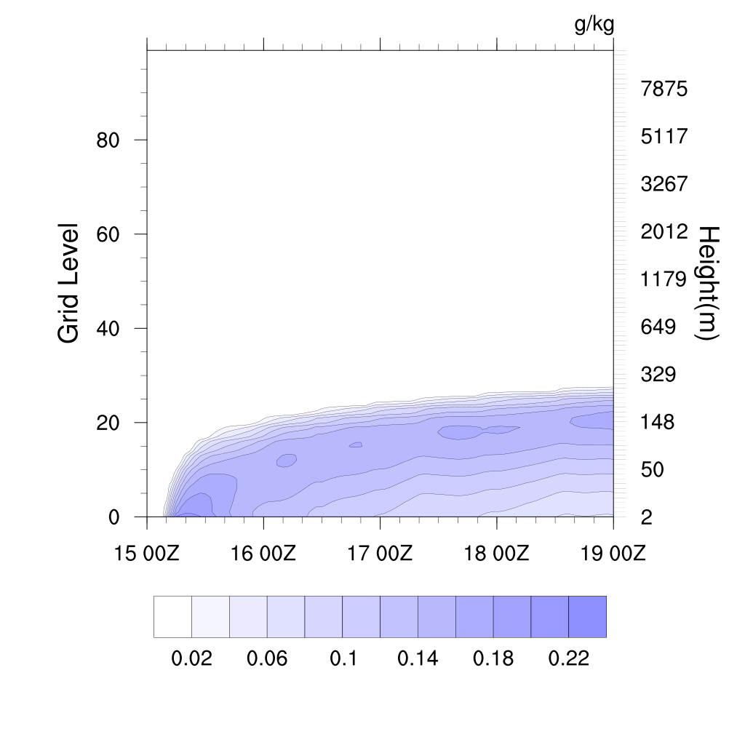
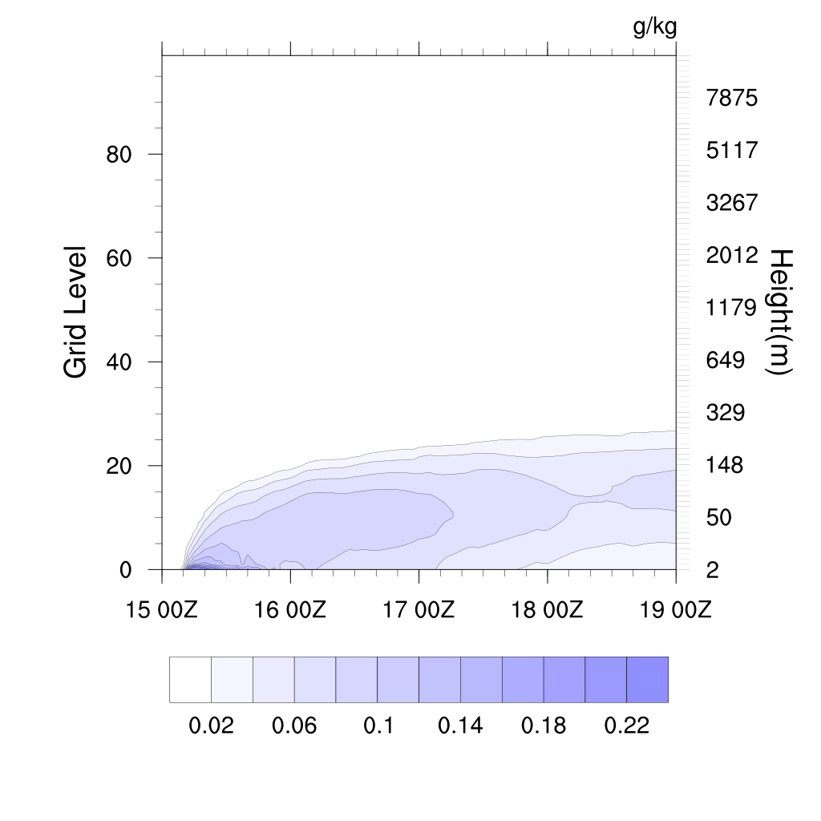
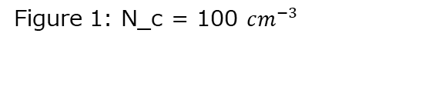
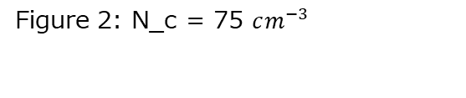
Comparison of LWC for maritime cases for Thompson 2008 and 2014.
Figure 1: N_c = 100 $cm^{−3}$
Figure 2: N_c = 75 $cm^{−3}$
Figure 3: Thompson Aerosol-Aware (2014)

Slide 10
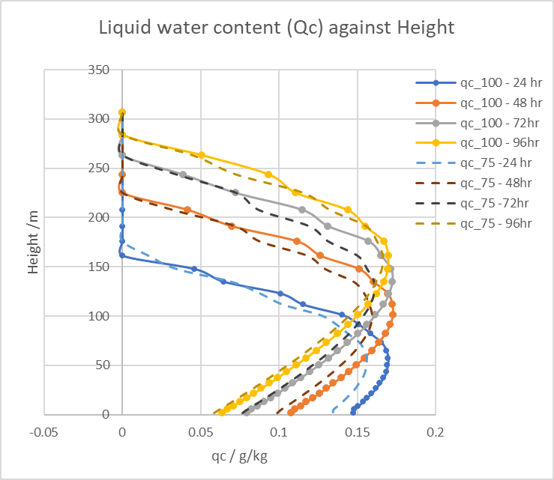

Comparison of LWC against height for Thompson scheme
The dotted lines represent $N_{c}$ = 75 $cm^{−3}$
Compared to initial data, there is a decrease in LWC.
Figure 5: Qc against Height Comparison between $N_{c}$=100 $cm^{−3}$and 75 $cm^{−3 }$for Thompson (2008) microphysics scheme.

Slide 11
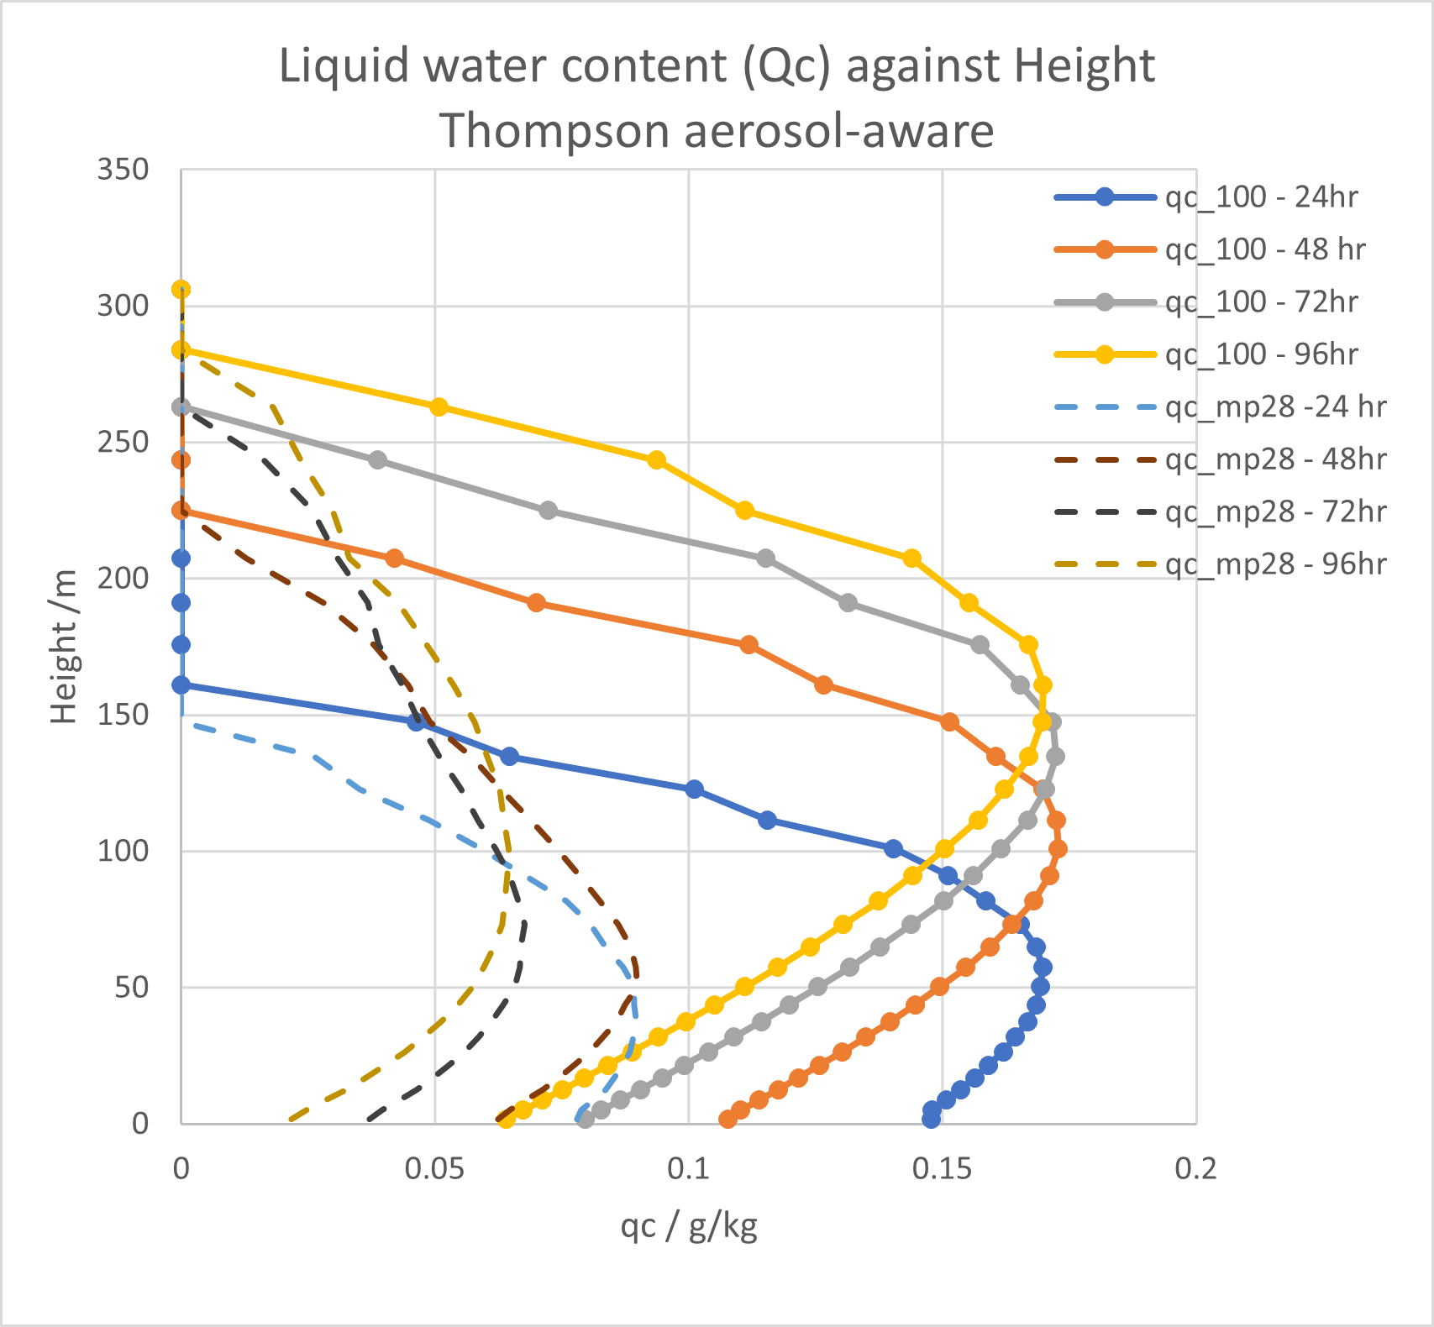
Comparison of LWC against height for Thompson aerosol-aware scheme
The dotted lines represent Thompson Aerosol-Aware.
There is a significant decrease in LWC compared to the original.
Figure 6: Qc against Height Comparison between Thompson (2008) microphysics and Thompson (2014) aerosol-aware.

Slide 12

Analysis of output
I used the percentage decrease formula given below to find how much the LWC decreased at 00:00 UTC for each day:
Percentage decrease =$\frac{N_{c100}−N_{c75}}{N_{c100}}$*100
The percentage decrease at each vertical level.
Average percentage decrease for the day.

Slide 13
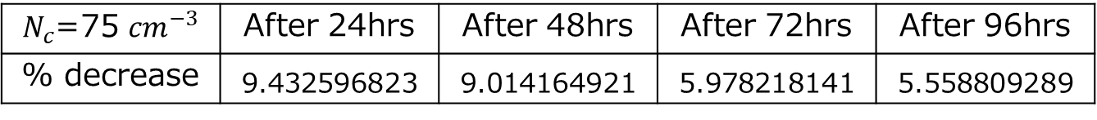
Analysis of output
$N_{c}$=75 ${cm}^{−3}$ | After 24hrs | After 48hrs | After 72hrs | After 96hrs
% decrease | 9.432596823 | 9.014164921 | 5.978218141 | 5.558809289
Figure 7: Table of mean percentage decrease for each day comparing original with $N_{c}$=75 ${cm}^{−3}$ for the Thompson scheme.
Thompson(2014) | After 24hrs | After 48hrs | After 72hrs | After 96hrs
% decrease | 50.305688666 | 49.876277120 | 57.604611702 | 59.554538955
Figure 8: Table of mean percentage decrease for each day comparing original with the Thompson Aerosol-Aware scheme.

Slide 14

Analysis of output
Fog reduces visibility below 1 km [6]
Used the daytime visibility equation (for simplicity) given below:
$$V_{k}= \frac{1.24ρ_{w}^{2/3}}{LWC^{2/3}N^{1/3}}$$
, where $ρ_{w}^{}$ is the density of water in kg/$m^{3}$ ,LWC in kg/$m^{3}$ and N is in $m^{−3}$ [7]

Slide 15
Analysis of output
Visibility was calculated near the surface (z = 1.6 m)
Visibility/m | After 24hrs | After 48hrs | After 72hrs | After 96hrs
Nc=100 | 37.44445 | 46.22861 | 56.55745 | 65.40787
Nc=75 | 39.85451 | 48.97966 | 58.00246 | 69.36349
Aerosol-Aware | 224.83444 | 235.82130 | 401.35534 | 491.91817
Figure 9: Table containing visibility at 00:00 UTC for each day of the simulation at height z= 1.6m for each case ( original, when Nc is changed to 75 $cm^{−3}$ and Thompson aerosol-aware).

Slide 16
Results
7%
55%
Decrease in LWC
Decrease in LWC
in the Thompson
in the Thompson aerosol-aware
3 m
300 m
Increase in visibility
Increase in visibility
key findings

Slide 17
Future Work
To validate those findings, we need to compare them with observations.
Investigate the Thompson Aerosol-Aware scheme and understand how radiation is involved in marine fog.

Slide 18
References
Skamarock, W. C., J. B. Klemp, J. Dudhia, D. O. Gill, Z. Liu, J. Berner, W. Wang, J. G. Powers, M. G. Duda, D. M. Barker, and X.-Y. Huang, 2019: A Description of the Advanced Research WRF Version 4. NCAR Tech. Note NCAR/TN-556+STR, 145 pp. doi:10.5065/1dfh-6p97
DTC, “Hierarchical Model Development And Single Column Models”,2018. URL: https://dtcenter.org/news/2018/03/hierarchical-model-development-single-column-models
Gregory Thompson et al., “Explicit Forecasts of Winter Precipitation Using an Improved Bulk Microphysics Scheme. Part II: Implementation of a New Snow Parameterization”, AMS, 136, 5095-5115, 2008
Gregory Thompson et al., “A Study of Aerosol Impacts on Clouds and Precipitation Development in a Large Winter Cyclone”, AMS, 71, 3636-3658, 2014.
Peter Taylor et al., “Surface deposition of marine fog and its treatment in the Weather Research and Forecasting (WRF) model”, Atmos. Chem. Phys., 21, 14687–14702, 2021
AMS, “Fog”, Glossary of Meteorology. URL: https://glossary.ametsoc.org/wiki/Fog
Isaac et al., “Characterizing and Predicting Marine Fog Offshore Newfoundland and Labrador”, AMS Vol 35: Issue 2, pp 347-365. DOI: https://doi.org/10.1175/WAF-D-19-0085.1

